Slide 1
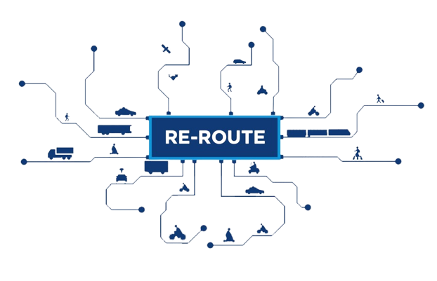
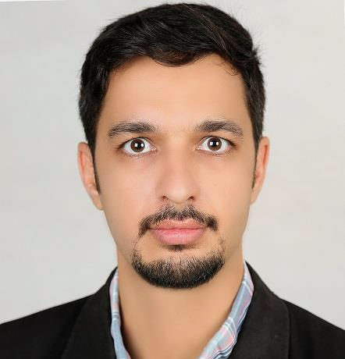
INTEGRATED INTELLIGENT MULTI-MODAL TRANSPORT INFRASTRUCTURE:
DISTRIBUTED LOCALISED DECISION-MAKING AT THE NETWORK EDGE
Dr. Ramin Ghiasi is a Postdoctoral researcher working on developing AI algorithms for Structural Health Monitoring. He completed his PhD in Civil Engineering at the University of Sistan & Baluchestan (USB) in 2019 which was focused on “Probability-based intelligent health monitoring of structures using metaheuristic optimization algorithm, big data analysis and surrogate methods”. After that, he joined to International Institute for Urban Systems Engineering (IIUSE) at Southeast University as an adjunct research assistant professor and did research in the domains of sustainable infrastructure and hysteresis modeling. His main research interests are structure/infrastructure monitoring using advanced AI algorithms, big data in civil engineering, and wavelet applications in structural engineering.
This project has received funding from the European Union’s Marie Skłodowska-Curie Actions (MSCA), Staff Exchanges under grant agreement No 101086343.

Slide 2
INTEGRATED INTELLIGENT MULTI-MODAL TRANSPORT INFRASTRUCTURE:
DISTRIBUTED LOCALISED DECISION-MAKING AT THE NETWORK EDGE
Bio
Sending institution
Logo
Host institution
Logo
This project has received funding from the European Union’s Marie Skłodowska-Curie Actions (MSCA), Staff Exchanges under grant agreement No 101086343.

